Slide 2
LINEAR EQUATION: A Linear Equation is an algebraic equation in which terms are a constants or the product of a constants and variables. Linear Equations can have one or more variables.Ex:2x-3=5(linear equation in one variable)
Ex:2x+3y=7(linear equation in two variables)

Slide 8
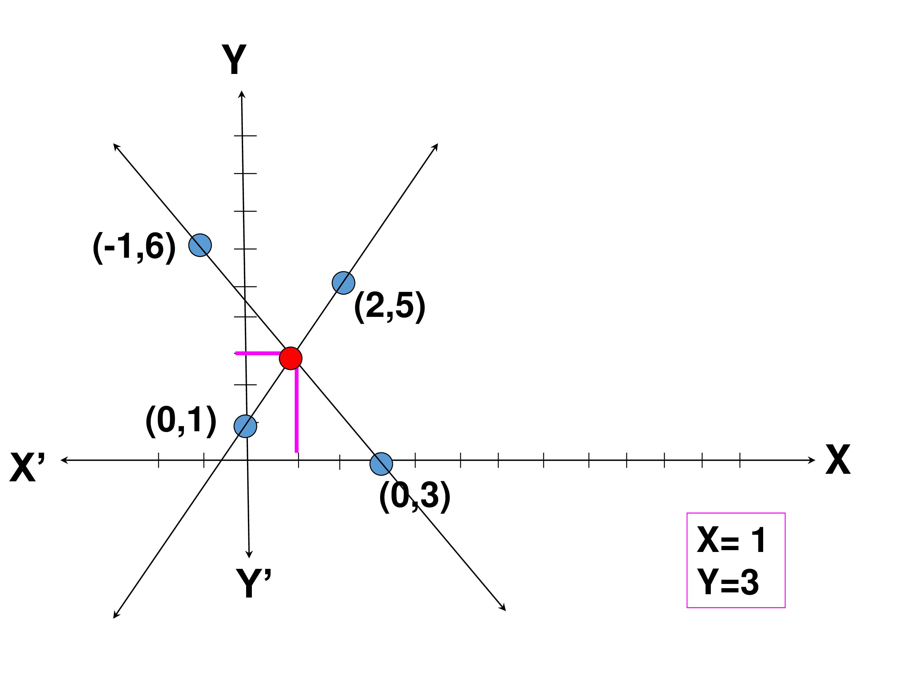

Slide 10
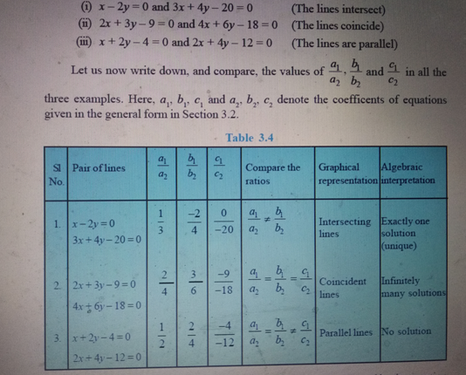

Slide 20
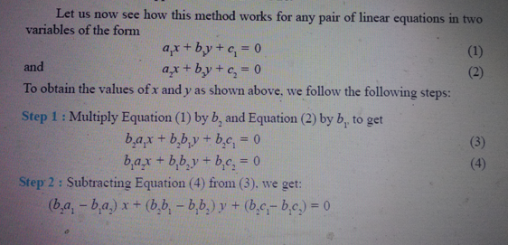
CROSS MULTIPLICATION METHOD

Slide 22
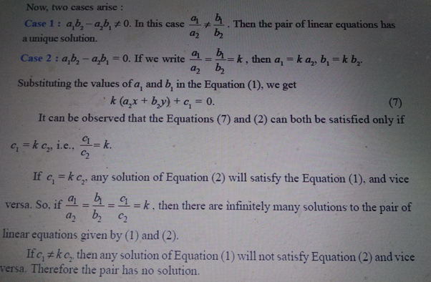

Slide 23
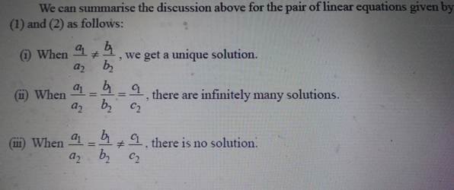

Slide 26
=x/ (-300+46) = y/ (161+220) =1/ (-22-105)
=x/ (-254) = y/ (381) =1/ (-127)
x=-254/-127=2
y=381/-127=3
x=2
y=3

